Slide 1
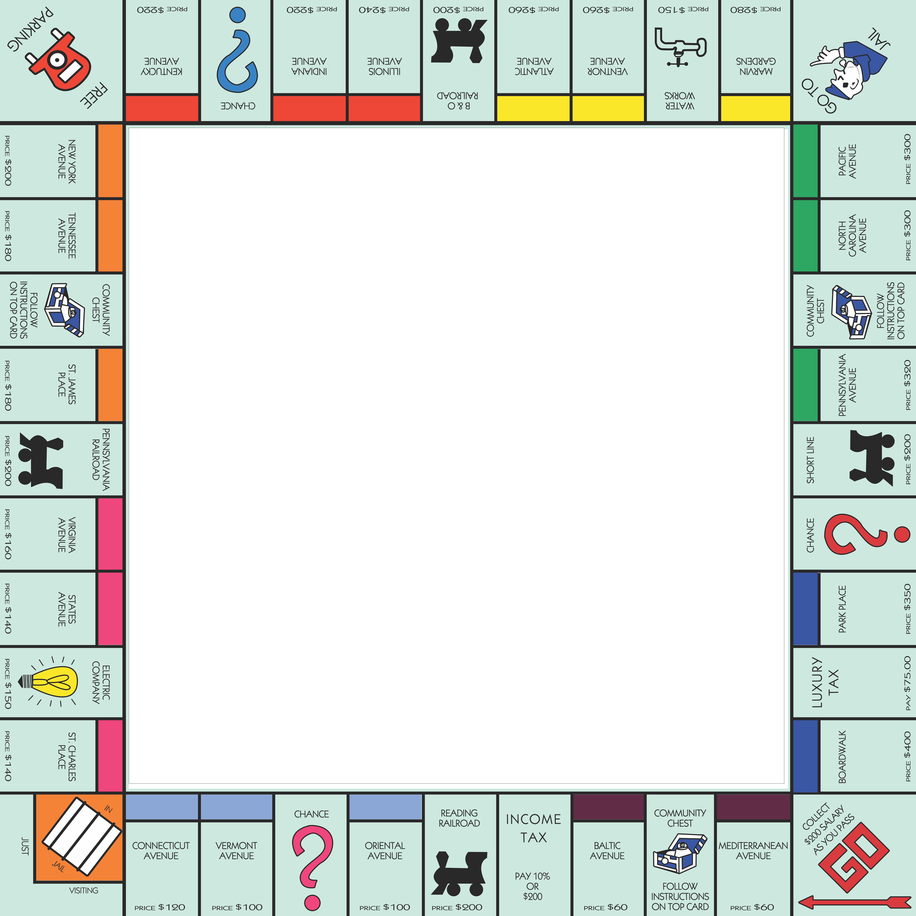
Markov Chains in the Game of Monopoly
Linear Algebra and Matrix Analysis
Taylor Marx, Nathan Jensen, John Navarro,
Gordon Dri, John Balcarcel

Slide 2
Table of Contents
1 | Problem Description
2 | Introduction to Markov Chains
3 | Execution and Code Development
4 | Simulation
5 | Conclusions

Slide 3
Problem Description

Slide 4


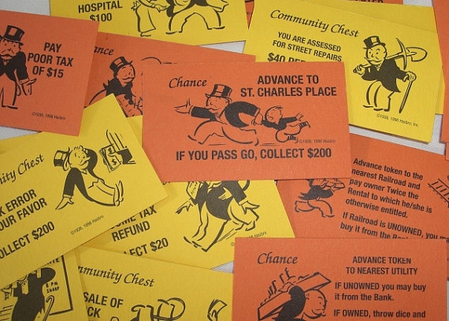
Monopoly the Game
How to play Monopoly
Objective is to force your competition into bankruptcy and own the Monopoly

Slide 5
Problem Description
The problem statement
Any serious strategy for monopoly must provide the player with well-founded advice on making the choices that arise in the game, such as:
Which properties are worth purchasing?
Which properties to develop houses/hotels first?
Which properties should I sell or trade to other players?
Just as in real-world real estate transactions the costs of investments must be weighed against the prospective returns
The prognosis of returns can be made only on the basis of probabilities and expectations
Our Approach
Develop a finite state Markov process to determine the probability that an opponent will land on a given property and leverage these probabilities to calculate expected rent for each property

Slide 6
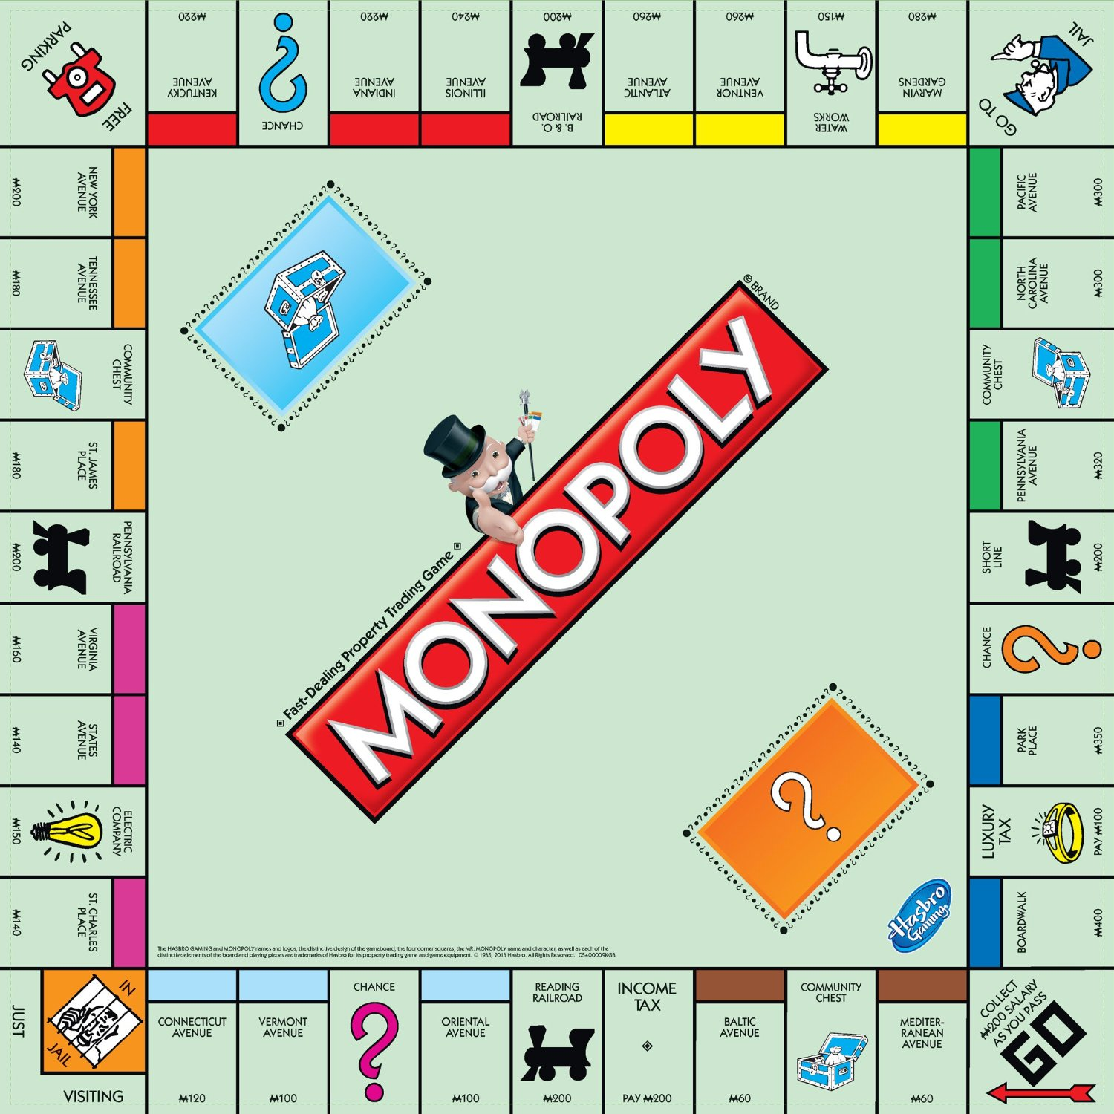
Most Valuable Properties

Slide 7
Introduction to Markov Chains

Slide 8
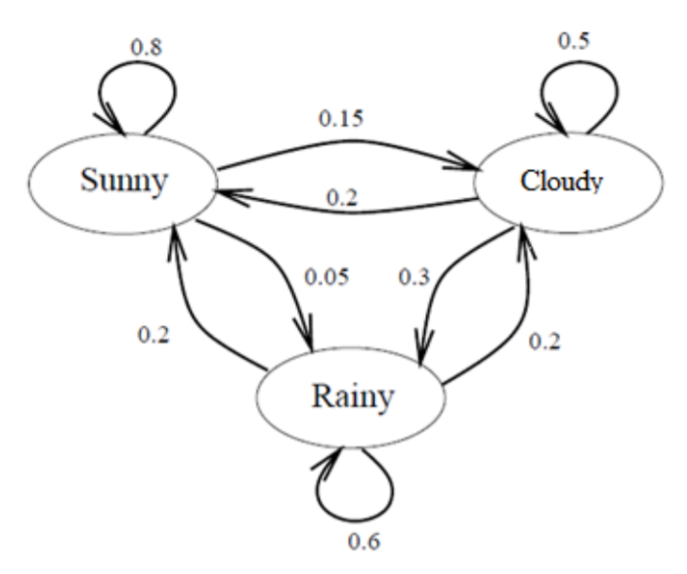
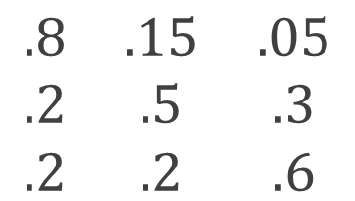
Markov Model: Overview / Assumptions
Example Markov Model for Weather Prediction
Representative Transition Matrix (T)
End State
Sunny
Cloudy
Rainy
Sunny
$$\begin{matrix}.8 & .15 & .05 \\ .2 & .5 & .3 \\ .2 & .2 & .6\end{matrix}$$
Begin State
Cloudy
--
State
Rainy
Transition Probability
Markov Model Assumptions
Markov Property: Probability that an event occurs on the (n+1)th trial depends only on the nth trial
Sojourn in a State: A finite number of states whose changes take place at fixed intervals in random fashion
Transition probabilities: Each states probabilities must sum to 1

Slide 9











Markov Model: Predicting Future States
Future states of the system can be found under the general equation:
$${x_{n}=x}_{n−1} ∗T$$
Example: If today is cloudy, what will be the weather the day after tomorrow?
Transition Matrix (T)
Initial State X0
$$\begin{matrix}.8 & .15 & .05 \\ .2 & .5 & .3 \\ .2 & .2 & .6\end{matrix}$$
State X1
Step 1: Find the weather for tomorrow (𝑥₁), by multiplying today’s weather (𝑥₀), by the transition matrix (T)
$$\begin{matrix}0 & 1 & 0\end{matrix}$$
$$\begin{matrix}.2 & .5 & .3\end{matrix}$$
$$x_{1}=x_{0} ∗T=$$
$$=$$
Transition Matrix (T)
Probability of sunny, cloudy, or rainy on day 2
Step 2: Repeat step 1 to find the weather for the day after tomorrow
State X1
$$\begin{matrix}.8 & .15 & .05 \\ .2 & .5 & .3 \\ .2 & .2 & .6\end{matrix}$$
$$\begin{matrix}.2 & .5 & .3\end{matrix}$$
$$\begin{matrix}.32 & .34 & .32\end{matrix}$$
$$x_{2}=x_{1} ∗T=$$
$$=$$

Slide 10


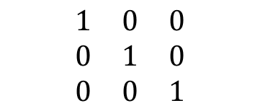


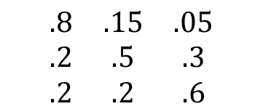


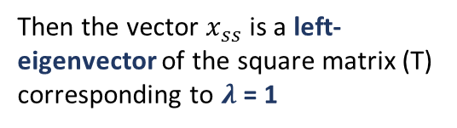

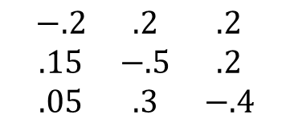

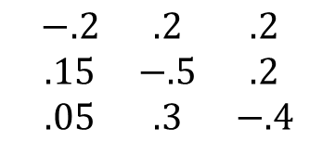
Markov Model: Steady State Distributions
Unknown steady state vector 𝑥_{𝑠𝑠}
1
Transition Matrix (T)
Identity Matrix (I)
Solve with Null space
$$\begin{matrix}.8 & .15 & .05 \\ .2 & .5 & .3 \\ .2 & .2 & .6\end{matrix}$$
$$\begin{matrix}1 & 0 & 0 \\ 0 & 1 & 0 \\ 0 & 0 & 1\end{matrix}$$
$x_{ss}∗T=$ $x_{ss}$
$$\begin{matrix}x \\ y \\ z\end{matrix}$$
$x_{ss}∗T−x_{ss}=$ 0
$x_{ss}∗(T−I)=$ 0
$$\begin{matrix}−.2 & .2 & .2 \\ .15 & −.5 & .2 \\ .05 & .3 & −.4\end{matrix}$$
Solving for the null space (Ax=0) gives the steady state distribution
$$\begin{matrix}x \\ y \\ z\end{matrix}$$
$$\begin{matrix}0 \\ 0 \\ 0\end{matrix}$$
${\left(T−I\right)}^{T}∗x_{ss}=$ 0
$$=$$
2
If a vector remains unchanged when multiplied by a square matrix:
Solve with Eigenvectors
To find the eigenvectors, we solve the general equation:
$$\begin{matrix}−.2 & .2 & .2 \\ .15 & −.5 & .2 \\ .05 & .3 & −.4\end{matrix}$$
$$\begin{matrix}x \\ y \\ z\end{matrix}$$
$$\begin{matrix}0 \\ 0 \\ 0\end{matrix}$$
$x_{ss}∗T=$ $λ$ ${∗ x}_{ss}$
$$=$$
Then the vector $x_{ss}$ is a left-eigenvector of the square matrix (T) corresponding to $λ$ = 1
$$\left(T − λ I\right)x=0$$

Slide 11
Treating Monopoly as a Markov Process
Markov Model Assumptions
Monopoly Transition Matrix
Discrete Markov States: The 40 properties on the Monopoly board along with 2 jail states will each become a “Markov State”
Markov Property: Each dice roll is independent and outcome is related only to current position
Transition probabilities: The sum of the “END” probabilities for each property will sum to 1
Steady State: Eigenvalue of the transition matrix (see right) is equal to one, which confirms a steady state exists
 | Go | Mediter. Avenue | Community Chest |  |  | Park Place | Luxury Tax | Boardwalk
Go | 0 | 0 | 1/36 |  |  | 0 | 0 | 0
Mediterranean Avenue | 0 | 0 | 0 |  |  | 0 | 0 | 0
Community Chest | 0 | 0 | 0 |  |  | 0 | 0 | 0
Park Place | 1/18 | 1/12 | 1/9 |  |  | 0 | 0 | 1/36
Luxury Tax | 1/36 | 1/18 | 1/12 |  |  | 0 | 0 | 0
Boardwalk | 0 | 1/36 | 1/18 |  |  | 0 | 0 | 0
. . .
. . .
. . .
. . .
. . .
. . .
. . .
. . .
. . .
. . .
. . .
. . .
Treating the board as a Markov Model allows us efficiently find the long-term probability distribution through linear algebra methods

Slide 12
Code Development and Execution

Slide 13
Simulation

Slide 14
Monopoly Simulation
Empirically proving the steady state through probability
Perform manual multiplications of the transition matrix to get to the steady state
Will show probability distribution vectors at the 1st, 2nd, & 3rd state
Continue to show transition matrix multiplied by probability to get to the steady state
How many iterations (or dice rolls) to get to the steady state?

Slide 15
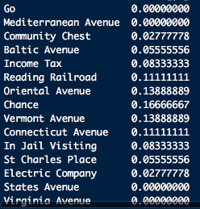
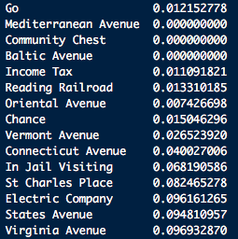
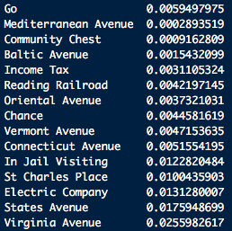
1st, 2nd, 3rd Multiplications
Multiply the transition matrix by the probability distribution vector at state 0 to obtain the probability distribution vector at state 1 (i.e. 1 turn later)
Continue multiplying by the probability vector to get to vector state 2 and vector state 3.
# Show in graph

Slide 16
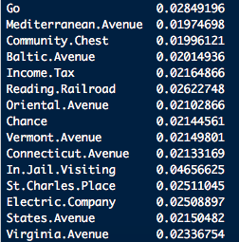
Steady State Vector
Perform programmatic multiplications of the transition matrix by the probability distribution vectors at states 1, 2, 3 and until the steady state (i.e state i)
1,000 iterations
Epsilon = 1e-100

Slide 17
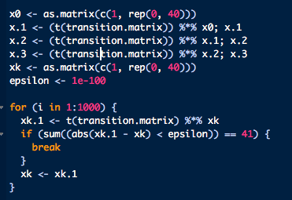
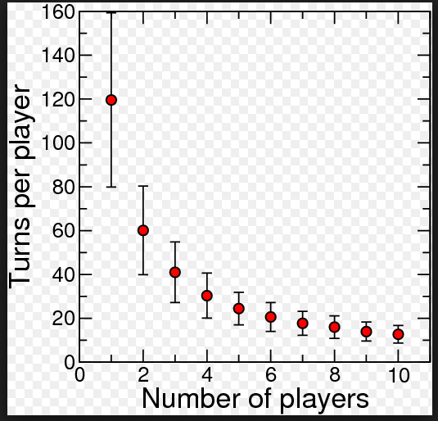
# of Iterations to Steady State
Epsilon = 1e-100
427 iterations to get to Steady State
What is the average number of turns in a monopoly game?

Slide 18
Conclusion

Slide 19
Conclusions
Apply rents to steady state
State Assumptions
At the start of the game each space is occupied and has a hotel
Players own all of the group properties
Chance and Community Chest cards are shuffled back into the deck
4 people are playing the game

Slide 20
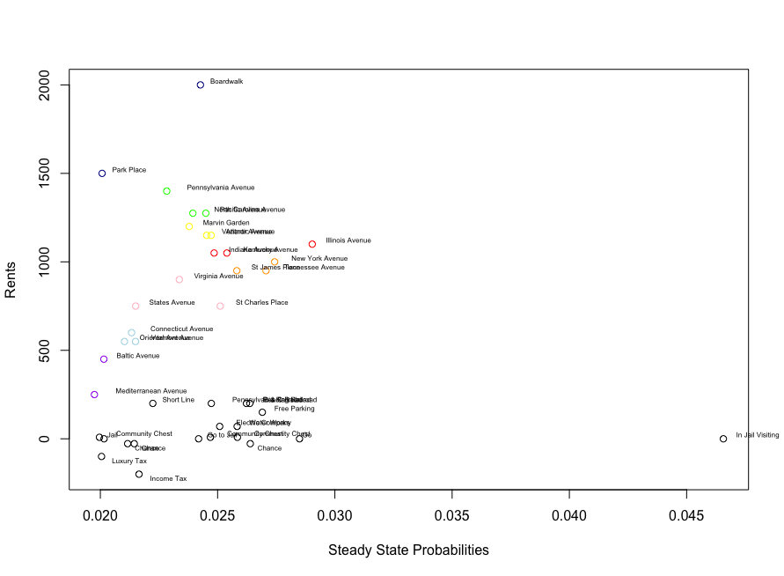
Strategy
Acquire properties with the highest rents
Boardwalk, Illinois, and St Charles stand out due to cards
Avoid Rail Roads and Utilities

Slide 21
Other Considerations
Other Considerations
Our assumptions are based on the long-term
This may not be the optimal strategy for a shorter game
Future Enhancements
Consider costs of properties and compute break-even point
Consider value of completing group to evaluate trades

Slide 22
Appendix

Slide 23
Outline
Set up problem (John)
Explain game
How to play
Objective
Game assumptions
Assuming no jumping around, each square would be equally rolled over time
We ran solving using Markov Chains
Introduce Markov Chains (Jack)
Basic theory of Markov Chains
Conditions that has to be met (tie this back to the game) & adjust our model
Steady State
Short Example - theory
Illustratively show show matrix
Code Walk Through (Gordon)
Explain each step – connect each line to theory
Solve steady state matrix → prove it with simulation
Simulation – empirically (Taylor)
Prove steady state with simulation
Transition Matrix
Repeat a lot, show 1st few turns compare to steady state…
Conclusions (Nate)
Apply rents
State assumptions
Draw conclusions
Here’s where you buy
Other considerations
Further enhancements

